Slide 1


The Salvation of the Soul

Slide 2
1 Peter 4:1-6

Slide 3

Salvation of the Soul
1 PETER
What is the Salvation of the Soul?
The Salvation of the soul is the total transforming work of God upon our lives, which is presently being realized in the midst of Christ like suffering, and which in the future will be unveiled in Christ like glory.

Slide 4
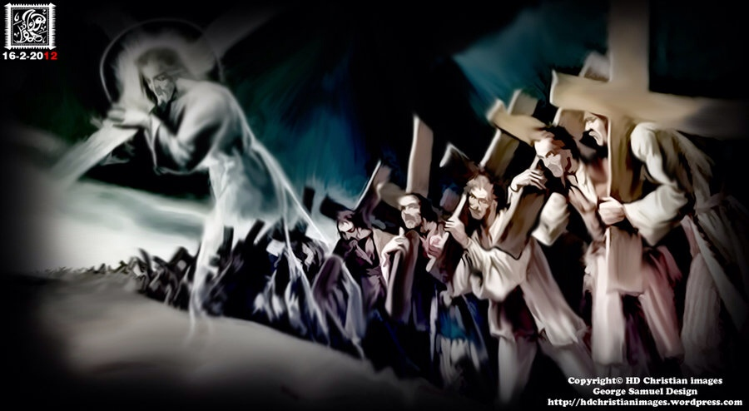
Salvation of the Soul
1 PETER
We are called to patiently endure unjust suffering just as Christ showed us the way to suffer.
Notes:
The example set before us is set in the past. Jesus shows us the way to suffer, to die, to live. We follow Him in the way to suffer and in the way of submission. Christ’s sufferings are the model on how to respond to injustice, for He experienced the greatest injustice of all. So we too are told to take up your suffering and follow Him in His footsteps. There are many others in the past who have taken up their crosses and suffered for Him patiently, like Noah while building the Ark.

Slide 5
Salvation of the Soul
1 PETER
Outline

Slide 6
Salvation of the Soul
1 PETER
Body: Salvation of the Soul, Worked out in Experience – 1:13 – 4:19
In Relation:
to God – 1:13-21
to Brethren – 1:22 – 2:10
to the World – 2:11 – 3:7
to Life Itself – 3:8 – 4:6
to the Consummation of History – 4:7-19

Slide 7
Salvation of the Soul
1 PETER
Body: Salvation of the Soul, Worked out in Experience – 1:13 – 4:19
In Relation:
to Life Itself – 3:8 – 4:6
Through the Experience of Blessing – 3:8-12
Through the Experience of Suffering – 3:13 – 4:6
Key Phrase: “For he who desires to love life and see good days.”
Notes:
If we are rightly related to God, to the brethren, and to the world around us, then we are ideally prepared for a long life and good days. And even if we suffer, we are still victorious in the life of our Savior.
The key phrase in this section is, “For he who desires to love life and see good days” Life is lengthened and days are made happy or good by a gracious behavior toward others. And Scripture is repeatedly clear that life is shortened when our days are characterized by wickedness.

Slide 8
Salvation of the Soul
1 PETER
Through the Experience of Suffering – 3:13 - 4:6
Suffering for Doing Good – 3:13-17
Suffering Identified through the Medium of Typology – 3:18-22
Suffering with the Same Mind of Christ – 4:1-6
“But even if you should suffer for righteousness' sake, you are blessed.” (3:14a)
Notes:
In the first subsection, vs 8-12 Peter explains that the salvation of the soul is experienced through life itself by gaining a long and happy life that good conduct brings to it from God. There is only blessing from God for living a righteous life. But what about man? What can we expect man to bring to us for living a life of good conduct. Tranquility is normally to be expected from such a life, but should suffering come, there is blessedness even in it.
We should not be surprised when persecution or suffering for doing good comes from men, spite the fact of believers desire to live peacefully and their eagerness to do good.
Peter present the principles of suffering for good conduct in verses 13-17, and then provides examples of suffering for good conduct through the medium of typology in verses 18-22.

Slide 9
Salvation of the Soul
1 PETER
Through the Experience of Suffering – 3:13 - 4:6
Suffering for Doing Good – 3:13-17
Blessings from God for Good Conduct
Sufferings from Man for Good Conduct
“But even if you should suffer for righteousness' sake, you are blessed.” (3:14a)
Notes:
Peter present the principles of suffering for good conduct in verses 13-17, and then provides examples of suffering for good conduct through the medium of typology in verses 18-22.

Slide 10
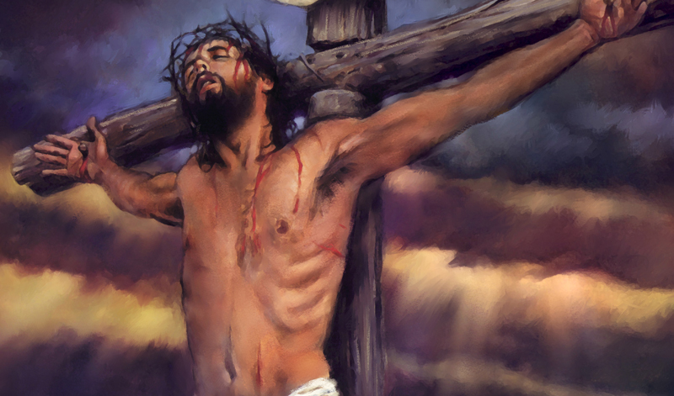
Salvation of the Soul
1 PETER
Suffering Identified through the Medium of Typology
“For Christ also suffered once for sins, the just for the unjust, that He might bring us to God, being put to death in the flesh but made alive by the Spirit.” (3:18)

Slide 11
Salvation of the Soul
1 PETER
Suffering Identified through the Medium of Typology
“by whom also He went and preached to the spirits in prison, who formerly were disobedient, when once the Divine longsuffering waited in the days of Noah, while the ark was being prepared, in which a few, that is, eight souls, were saved through water.” (3:19-20)
Notes:
Note: Verses 19-20 involves three elements in God’s dealing with man: proclamation, patience and preservation. All three have parallels and relevance for Peter’s day and ours. We need to know that the rebellious, who are doomed in divine judgement are without excuse, they are responsible, hear the proclamation of its coming. God is waiting in great patience before the judgment comes, while the church (Ark) is being built. There is salvation, but for a few who heed the call in comparison to the mass of mankind.

Slide 12
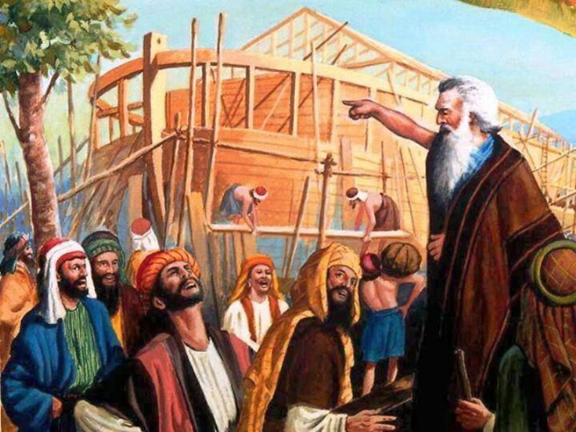
Salvation of the Soul
1 PETER
Suffering Identified through the Medium of Typology
“Noah was “a preacher of righteousness” (2 Pt. 2:5)
Christ preached to the spirits through Noah of their coming dome.
Notes:
“Christ went in His Spirit and preached through Noah “a preacher of righteousness” (2 Pt. 2:5) in the days prior to the global flood to the unclean spirits who left heaven and were roaming the earth influencing men to commit violence. These spirits are now held in prison.

Slide 13
Salvation of the Soul
1 PETER
Suffering Identified through the Medium of Typology
“spirits” always refers to “unclean spirits”; demons.
“spirits” are called “sons of God” who came before the Lord with Satan (Job 1:6; 2:1; 38:4,7), and are equated with angels (Lk. 20:36).
“spirits” angels who sinned are said to be now in prison (2 Pt. 2:4; Jude 6; Rev. 18:2-3; 20:7)
Notes:
Who are the “spirit” that the spirit Christ spoke to through Noah?

Slide 14
Salvation of the Soul
1 PETER
Suffering Identified through the Medium of Typology
Who did the Preaching?
Christ’s Spirit Preached
Who did He Preach too?
Unclean Spirits
How did He Preach?
In His Spirit through Noah
When did He preach?
In the days Noah
What did He Preach?
Impending Judgment
Notes:
Christ preached impending doom through Noah by His Spirit to the unclean spirits who were influencing the hearts or minds of men in the days or years prior to the flood. As in Noah’s day the “in Spirit Messiah” proclaimed there doom, so today their doom is also proclaimed and is sure because He who was quickened “made alive” and is in heaven is exalted above them.” (Hodges, p. 70) that is, the angels and authorities and powers having been made subject to Him.

Slide 15
Salvation of the Soul
1 PETER
Suffering Identified through the Medium of Typology
“There is also an antitype which now saves us — baptism (not the removal of the filth of the flesh, but the answer of a good conscience toward God), through the resurrection of Jesus Christ, who has gone into heaven and is at the right hand of God, angels and authorities and powers having been made subject to Him.” (3:21-22)
Notes:
Here, the type is water baptism which is a outward illustration of the inner or hidden work of the spirit, “spirit baptism” which is the antitype. Water baptism is a visional illustration of an invisible spiritual work of the spirit that occurs at the moment of faith in Christ, that places the believer into the body of Christ.
The spirit baptism “saves us” including the salvation of the soul, “psyche”. We are not talking about “baptism regeneration” which says that water baptism saves the sinner for eternal punishment and regenerates, gives eternal life, that is, born again.
Noah and the ark are “also” a type, or a copy of a salvation of the soul, in which eight souls “psyche” were saved from a watery death. Spirit baptism the antitype of a spiritual reality which was foreshadowed in Noah’s day. Just as Noah and company was placed “into” the Ark saved eight souls from judgement and death, spirit baptism places “us” into Christ’s saving us from divine judgment and from the spirits who have been made subject to Him.

Slide 16
Salvation of the Soul
1 PETER
Baptism, a Work of Christ through the Spirit
Christ enters the sphere of the Spirit.
The Ark is an appropriate image of Christ into which we are placed in Spirit baptism.
Spirit baptism mightily effects and includes “us”.
Spirit baptism is the key to the phrase “in Christ”, making a connection to Romans 6.
Notes:
Four arguments for regarding baptism as a reference to the work of Christ through the Spirit.
The section begins (vs.18) with Christ’s entrance by resurrection into the sphere of the Spirit. Verses 19-22 establishes our identification with the experience of being put to death in the flesh but made alive by the Spirit through the medium of typology or picture form. The “in which” or “in whom” carries forward the stress of the “spirit nature” of the illustration.
Second, the Ark is actually in which the eight souls are placed saves them. It is not the water. The Ark is a appropriate image/type of Christ into which we are placed in the Spirit’s baptism. Notice in eight souls were saved when they went “into” the Ark.
Third, Peter uses “us” in reference to the effects of our baptism, including himself. It mightily effects us.
Forth, Peter had already mention in verse 16 the typically Pauline phrase “in Christ” Spirit baptism is the key to the phrase “in Christ”, making a connection to Romans 6. Peter is presenting the Paul’s doctrine of Romans 6.
Rom 6:1-11
“What shall we say then? Shall we continue in sin that grace may abound? Certainly not! How shall we who died to sin live any longer in it? Or do you not know that as many of us as were baptized into Christ Jesus were baptized into His death? Therefore we were buried with Him through baptism into death, that just as Christ was raised from the dead by the glory of the Father, even so we also should walk in newness of life. For if we have been united together in the likeness of His death, certainly we also shall be in the likeness of His resurrection, 6 knowing this, that our old man was crucified with Him, that the body of sin might be done away with, that we should no longer be slaves of sin. For he who has died has been freed from sin. Now if we died with Christ, we believe that we shall also live with Him, knowing that Christ, having been raised from the dead, dies no more. Death no longer has dominion over Him. For the death that He died, He died to sin once for all; but the life that He lives, He lives to God. Likewise you also, reckon yourselves to be dead indeed to sin, but alive to God in Christ Jesus our Lord.”
The climax of Christ going into heaven seating at the right of God having made the spirits subject to Him recalls Col. 2:11-15 and Eph. 1:20 – 2:10.
Col 2:11-15
“In Him you were also circumcised with the circumcision made without hands, by putting off the body of the sins of the flesh, by the circumcision of Christ, buried with Him in baptism, in which you also were raised with Him through faith in the working of God, who raised Him from the dead. And you, being dead in your trespasses and the uncircumcision of your flesh, He has made alive together with Him, having forgiven you all trespasses, having wiped out the handwriting of requirements that was against us, which was contrary to us. And He has taken it out of the way, having nailed it to the cross. Having disarmed principalities and powers, He made a public spectacle of them, triumphing over them in it.”
Eph. 1:20-21; 2:4-8
The Father of glory, “worked in Christ when He raised Him from the dead and seated Him at His right hand in the heavenly places, far above all principality and power and might and dominion, and every name that is named, not only in this age but also in that which is to come… But God, who is rich in mercy, because of His great love with which He loved us, even when we were dead in trespasses, made us alive together with Christ (by grace you have been saved), and raised us up together, and made us sit together in the heavenly places in Christ Jesus, that in the ages to come He might show the exceeding riches of His grace in His kindness toward us in Christ Jesus.”
In both of these passages baptism truth and triumph of Christ over angelic powers are closely linked. In Peter’s illustration like the Ark resting on Mt. Ararat through baptism we pass safely through the waters of death and have been “brought to God”

Slide 17
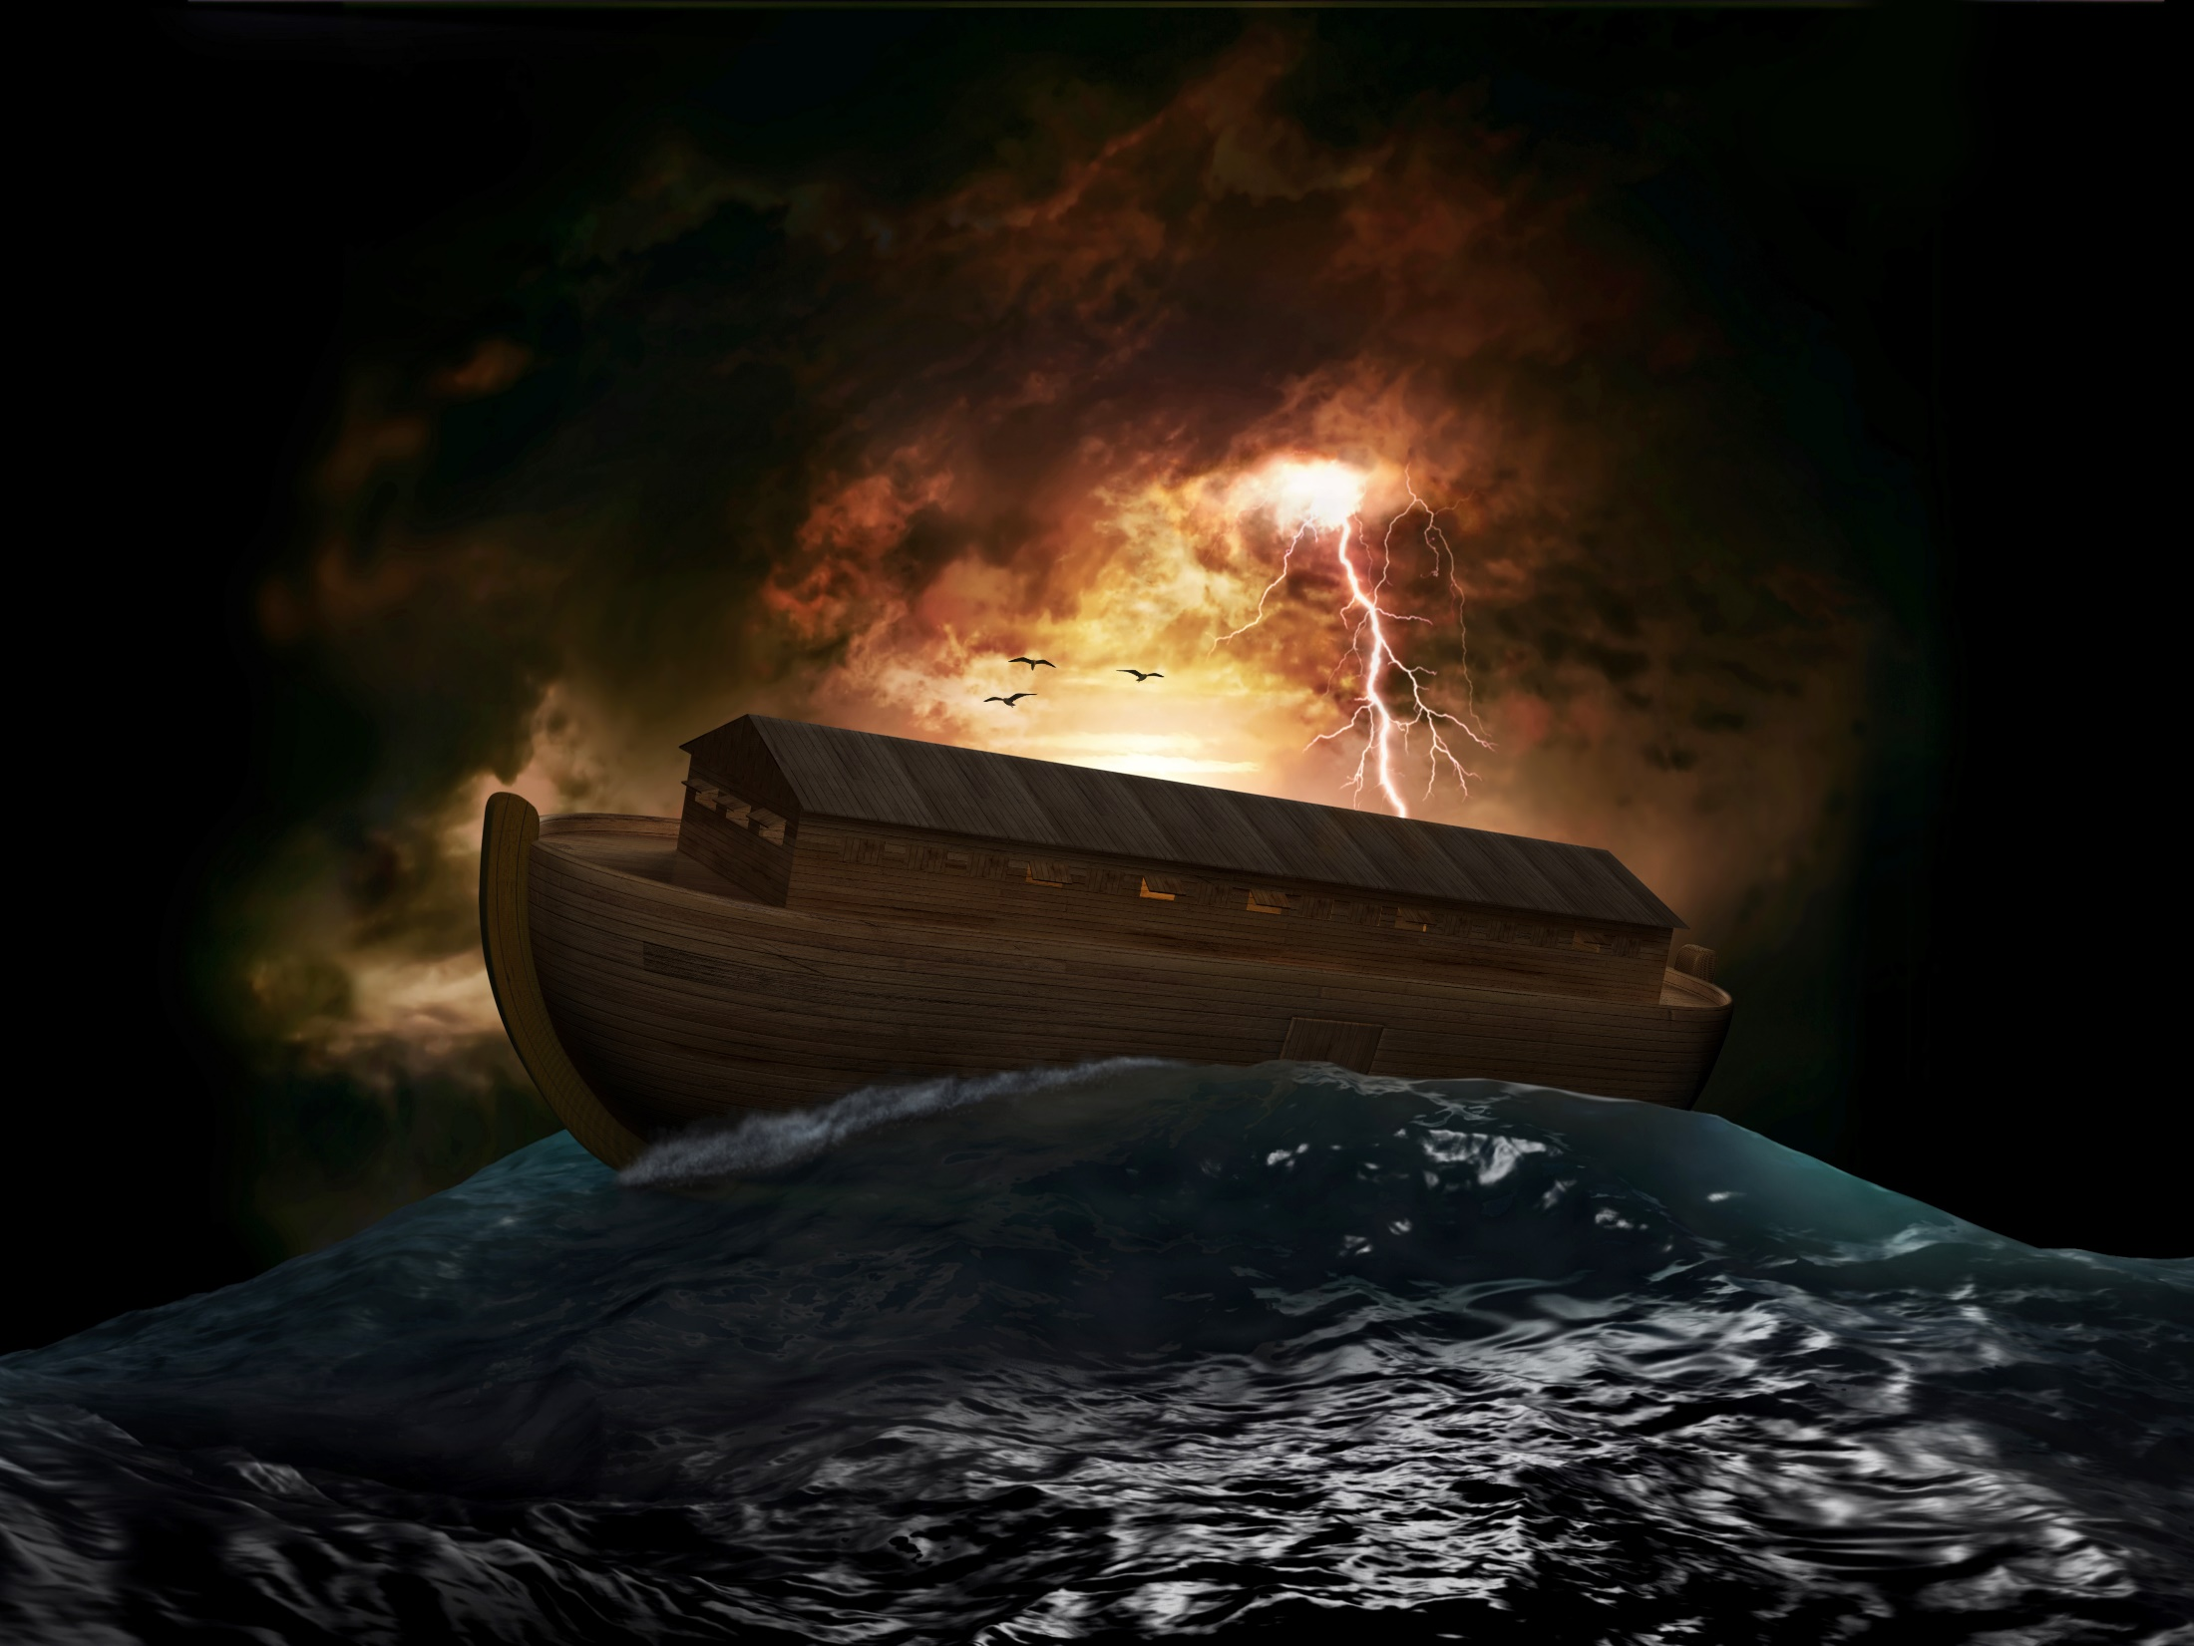
Salvation of the Soul
1 PETER
Spirit Baptism
Ark = Christ
“placing into”
In the Ark = In Christ
Hostile Doomed World

Slide 18
Salvation of the Soul
1 PETER
Type
Antitype
Ark
Christ
Noah and His Household placed into the Ark
Church placed into Christ
Saved by being in the Ark
Saved by being in Christ
“also”
Water Baptism
Spirit Baptism
Past Evil Age
Present Evil Age
Proclaimed Victory
Obtained Victory

Slide 19
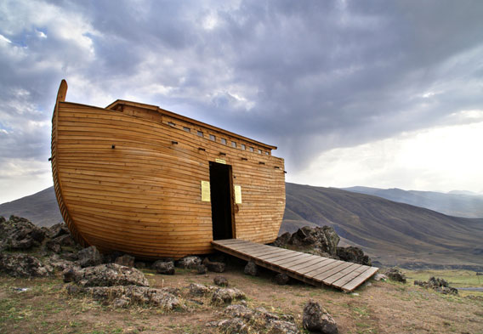
Salvation of the Soul
1 PETER
Through Spirit baptism we are linked to Christ’s dying and rising experience and are safely brought
to God.

Slide 20
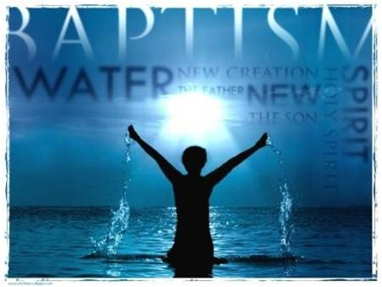
Salvation of the Soul
1 PETER
Suffering Identified through the Medium of Typology
“which now saves us — baptism (not the removal of the filth of the flesh, but the answer of a good conscience toward God), (3:21b)
Notes:
How does baptism save us?
Water baptism saves us by not be the removal of dirt from the body, but by the respond of a good conscience toward God.
Water baptism which makes a public announcement and identification with Christ may cause them to suffer persecution and may even endanger their physical life. But if they do identify with Christ their conscience is right. Failure to identify with Christ to avoid persecution will leave one with a bad conscience toward God.

Slide 21
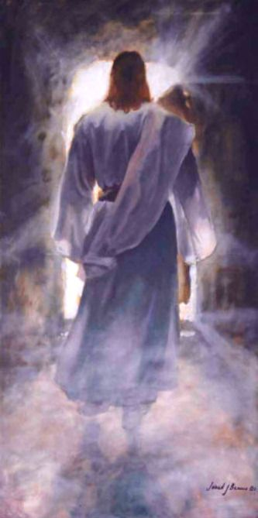
Salvation of the Soul
1 PETER
Suffering Identified through the Medium of Typology
“through the resurrection of Jesus Christ, who has gone into heaven and is at the right hand of God, angels and authorities and powers having been made subject to Him.” (3:21c-22)
Notes:
Spirit baptism saves us by being placed “into Christ” made possible by the resurrection and ascension of Christ. We have the promise of Christ “I am the resurrection and the life. He who believes in Me, though he may die, he shall live.” (John 11:25) Even if we were to die we are raised to life just as Christ was raised victorious and now sits in the place of authority, the spirits now having been made subject to Him.
Matt 10:28-29
“And do not fear those who kill the body but cannot kill the soul. But rather fear Him who is able to destroy both soul and body in hell.”
Luke 12:4-5
"And I say to you, My friends, do not be afraid of those who kill the body, and after that have no more that they can do. But I will show you whom you should fear: Fear Him who, after He has killed, has power to cast into hell; yes, I say to you, fear Him!”
Heb. 13:5-6
For He Himself has said, "I will never leave you nor forsake you." So we may boldly say: "The Lord is my helper; I will not fear. What can man do to me?"

Slide 22
Salvation of the Soul
1 PETER
Through the Experience of Suffering – 3:13 - 4:6
Suffering for Doing Good – 3:13-17
Suffering Identified through the Medium of Typology – 3:18-22
Suffering with the Same Mind of Christ – 4:1-6
“But even if you should suffer for righteousness' sake, you are blessed.” (3:14a)
Notes:
4:1 picks ups where 3:18 left off.

Slide 23
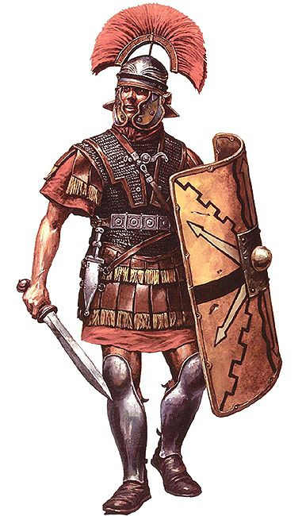
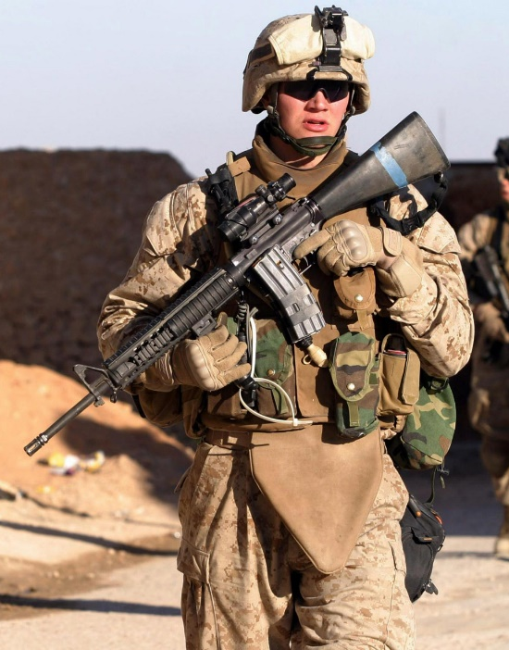
Salvation of the Soul
1 PETER
Suffering with the Same Mind of Christ – 4:1-6
“Therefore, since Christ suffered for us in the flesh, arm yourselves also with the same mind…” (4:1a)
Notes:
Prepare yourself with the same thinking concerning suffering. Be prepared to suffer for Christ if you identify with Him in baptism and good conduct.
Jesus prepared His disciples and said, “…you will be hated by all for My name's sake.” (Matt 10:22a)
John 15:18-19
"If the world hates you, you know that it hated Me before it hated you. If you were of the world, the world would love its own. Yet because you are not of the world, but I chose you out of the world, therefore the world hates you.”
So be prepared to be hated and to suffer persecution from the world.

Slide 24
Salvation of the Soul
1 PETER
Suffering with the Same Mind of Christ – 4:1-6
“for he who has suffered in the flesh has ceased from sin, that he no longer should live the rest of his time in the flesh for the lusts of men, but for the will of God.” (4:1b - 2)
Notes:
Who is it that has suffered in the flesh and has ceased from sin?
“he”? – Christ could not have ceased from sin since He never sinned.
“he”? – the follower of Christ who also suffers in Christ’s flesh/body has ceased from sin, that is, he is done with sin, a life of sin. He has broken with sin, “he has been released from sin”. As Paul said, “For he who has died has been freed from sin.” (Rom. 6:7).
We no longer need to suffer needlessly for sin since Christ suffered for us. If we do sin we will suffer the consequences.
We no longer need to live a life of sin, for ourselves or the lust of men, the little remaining time we have left to live in the flesh. We can now live our life for God, doing what pleases God, instead of doing what is pleasing to men. Saving our soul for God.
Other see suffering as a cleansing effect in the process. Believers who have identified with Christ and suffer with Christ cease to suffer for sin. Those who are living for God are not living for sin and the lust of men but now suffer now for good conduct. Christ is our example in this.

Slide 25
Salvation of the Soul
1 PETER
Suffering with the Same Mind of Christ – 4:1-6
“For we have spent enough of our past lifetime in doing the will of the Gentiles — when we walked in lewdness, lusts, drunkenness, revelries, drinking parties, and abominable idolatries.” (4:3)
Notes:
“we”? – Is Peter including himself? Probably not. There is no evidence he personally participate in these sins in the past. He could be referring to a collective “we”, that is, the Jews? Or he could be referring to humanity as a whole, which is generally true.
Here Peter elaborates on the lusts of men.
Men think they are saving their life, a life of wanted pleasure is the high life, the good life, the best life, but in reality they are losing their life, wasting it away. They seek maximum sensual pleasure though self-indulgence, but much energy is wasted and resources squandered in pursuing such things. “For whoever desires to save his life (soul) will lose it, but whoever loses his life for My sake and the gospel's will save it.” (Mark 8:35). Any believer who continues in this lifestyle will not save his soul, but lose his soul.
Lewdness – debauchery; shameless vulgar behavior; uncontrolled, unfettered behavior; complete self-indulgent and self-absorbed. They seek to flaunt their immorality.
Lust – evil and powerful desires including greed and sexual satisfactions.
Drunkenness – excesses of liquor.
Revelries – feasts and celebrations that included the above in group settings – group drinking and group sex, orgies often done openly for all to see.
Drinking Parties – gatherings for the sole purpose of getting drunk.
Abominable Idolatries – participating in all these excesses while worshipping false deities, worshipping creatures instead of the Creator. Violation of the first commandment.
Gal 5:19-21
“Now the works of the flesh are evident, which are: adultery, fornication, uncleanness, lewdness, idolatry, sorcery, hatred, contentions, jealousies, outbursts of wrath, selfish ambitions, dissensions, heresies, envy, murders, drunkenness, revelries, and the like;”
Rom 1:28-32
“And even as they did not like to retain God in their knowledge, God gave them over to a debased mind, to do those things which are not fitting; being filled with all unrighteousness, sexual immorality, wickedness, covetousness, maliciousness; full of envy, murder, strife, deceit, evil-mindedness; they are whisperers, backbiters, haters of God, violent, proud, boasters, inventors of evil things, disobedient to parents, undiscerning, untrustworthy, unloving, unforgiving, unmerciful; who, knowing the righteous judgment of God, that those who practice such things are deserving of death, not only do the same but also approve of those who practice them.”

Slide 26
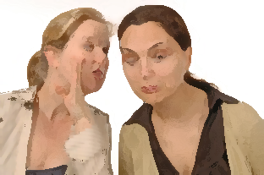
Salvation of the Soul
1 PETER
Suffering with the Same Mind of Christ – 4:1-6
“In regard to these, they think it strange that you do not run with them in the same flood of dissipation, speaking evil of you.” (4:4)
Notes:
In the unbelieving world, living in sin, does understand why someone would live the way a moral Christian does, or why someone would even want to do so. They think it is odd that not just that we do not want to participate in their excesses but also that we do not rush and eagerly desire to do so as well.
As a result they resort to speaking evil of you. They disapprove of those who do not join in on their fun. They live in a upside down world, where evil is good and good is evil. They seek to injure by demeaning, slandering and insulting us.
Today, there are those knowing in the hearts and minds that ways are evil but they want the approval of the world so as to ease the guilt they feel. They want the worlds approval so bad they are making attempts to even force people to do so. They want to penalize or even jailed someone for refusing to address an individual by the correct gender pronoun. You must address someone by their gender identity. They have sought harm and penalized a Christian bakery for refusing to bake a cake for an homosexual wedding.
They slandered and revile your good conduct in Christ (3:16).

Slide 27
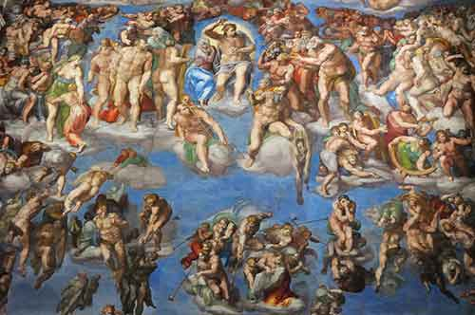
Salvation of the Soul
1 PETER
Suffering with the Same Mind of Christ – 4:1-6
“They will give an account to Him who is ready to judge the living and the dead.” (4:5)
Notes:
Peter warns that all who live in such a way that God stands ready to judge, that is, to condemn and to punish. Jesus closes the book of His revealing with same warning, “And behold, I am coming quickly, and My reward is with Me, to give to every one according to his work.” (Rev. 22:12-13) Everyone must be judged, whether they are alive or dead, when the time comes. The imminence of the Day is described with the word “ready”. It could be today. No one who knows yet when that day will be, so we must always be ready. It could come in two ways, 1) when we die, “And as it is appointed for men to die once, but after this the judgment:” (Heb. 9:27) or 2) at the Rapture, also known as the catching up, snatching, the gathering, the departure, to meet the Lord in the air. Jesus said, I will come like a thief in the night.
Peters warning is directed toward those who run in this dissipation. They will certainly give an account for their behavior. Justice will be served. Those who judge Christians unworthy will be judged.
We should also not forget that judgment begins with His people, “the brethren”, for James says, “Do not grumble against one another, brethren, lest you be condemned. Behold, the Judge is standing at the door! (5:9-10).
John 5:28-29
“Do not marvel at this; for the hour is coming in which all who are in the graves will hear His voice and come forth — those who have done good, to the resurrection of life, and those who have done evil, to the resurrection of condemnation.” Jesus was referring to Daniel 12:2, “And many of those who sleep in the dust of the earth shall awake, some to everlasting life, some to shame and everlasting contempt.”
Rev. 20:12-14
“And I saw the dead, small and great, standing before God, and books were opened. And another book was opened, which is the Book of Life. And the dead were judged according to their works, by the things which were written in the books. The sea gave up the dead who were in it, and Death and Hades delivered up the dead who were in them. And they were judged, each one according to his works.”
This is the sentencing stage of the trial, the verdict of their guilt or innocence was determined by whether one’s name was written in the book of life. Only those who obeyed the will of the Father by believing in Jesus for eternal life were eternally saved.

Slide 28
Salvation of the Soul
1 PETER
Suffering with the Same Mind of Christ – 4:1-6
“For this reason the gospel was preached also to those who are dead, that they might be judged according to men in the flesh, but live according to God in the spirit.” (4:6)
Notes:
Good news was announced to the dead. But who are the dead?

Slide 29
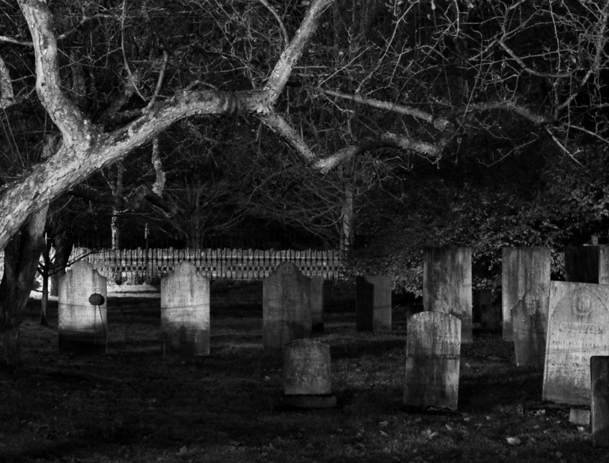
Salvation of the Soul
1 PETER
Suffering with the Same Mind of Christ – 4:1-6
Preaching the Gospel to the Dead?
To the Dead in Hell
To the Dead OT Saints
To the Spiritually Dead
To the Saints who are now Dead
Notes:
There is no second chance to those who are lost, they have been judged already (Heb. 9:27). Their destiny has already been determined.
The OT saints believed in the same message of life that all saints throughout the ages have heard. Trust in the Lord and thou shall be saved. Their destiny has already been determined. Beside Christ would not be preaching judgment to them.
All who hear the gospel on earth are spiritually dead. You and I were at one time dead spiritually. But then we believed and we came alive. So, the unregenerate who respond to the gospel “come alive” spiritually. Linking this to the baptism of the Spirit with the dying Savior we have been judged in the flesh like men, with the risen Lord, we live in the Spirit in reference to God.
The dead is taken in the same a physical sense as vs. 5 and 3:18, “Jesus was put to death in the flesh, but made alive in the spirit.” The dead are people who had the message of life preached to them and believed it before they died or were martyred. When they were alive, they were judged according to the flesh by being scorned by men (4:4) but will live according to God in the spirit. In the judgment of God the opinions of men will be reversed. “So even though pagans might condemn and execute Christians for not conforming to their society’s values, God will reverse that judgment and five them life with Him.” (Grace NT Commentary, p. 1163) Jesus said, even if you should die, you shall live forever.

Slide 30
Salvation of the Soul
1 PETER
Conclusion
Notes:
The summary of 1 Peter 3:8 – 4:6 is that on a physical level, life is prospered and lengthened by godly conduct (3:8-12). On a spiritual level, even in suffering, life is blessed even more (3:14) when it is lived in the Spirit to the will of God (3:18 – 4:6)
We save our souls when we continue to trust in Jesus, even when we suffer and are grieved by various trial, even when we suffer for doing good. We follow in His footsteps. This is the salvation of the soul.

